Slide 1

Restaurant Recommendation system
Presented by :
Raviteja Chakilam
Vineeth reddy pandala
Pranay paul reddy thirumala

Slide 2
Objectives
The main objectives of restaurant recommendation system are:
Exploring the data using visualizations
Building a user interactive Bengaluru restaurant recommendation system using content based recommendation and hybrid filtering methods using demographic and restaurant specific features.
Building content based recommendation systems for new users using similar reviews restaurants based on cosine similarity of the reviews
Building hybrid recommendation system using Matrix factorization method by using SVD(Singular Value Decomposition) algorithm
Mapping the recommended restaurant locality on the maps using geopy and folium Python modules

Slide 3
Related work
Different strategies are used to create recommendation systems while keeping in mind the target consumers and amount of reach. In this section, we review the research on machine learning advancements in terms of recommendation algorithms.
The similarity-based concept was the first step in the evolution of recommendation systems. Based on the similarity score, recommendations for items or products are made. In this study, recommendations were based on user and item similarities. According to experimental findings, item similarity received the highest F1 score [1].
This paper proposed multiple model based collaborative filtering methods to recommend the restaurants to the user. While recommending the restaurants it considers the various parameters like choice food, location of the restaurant, ratings, climate etc.,. This collaborative filtering method is used to predict the ratings of the restaurant considering a particular user.SVM classification model outperformed the KNN classifier [2].

Slide 4
Related work
When recommending products, content-based and collaborative filtering have their limitations. To get over the problems with content and collaborative filtering in this study, hybrid filtering is used. By comparing user ratings and restaurant characteristics, content-based results are produced. Utilising weighted, cluster-based, and similarity-based techniques, collaborative filtering is carried out. Both the collaboration and content outcomes are integrated in the hybrid method results. According to experimental findings, the hybrid filtering method performs better than the current methods [3].
Hybrid filtering method overcomes the traditional methods challenges.There are a handful of methods to perform hybrid filtering matrix factorization. In this method matrices of the combined features are reduced to lower rank and latent features are observed [4].

Slide 5
Problem Statement
Nowadays, ordering groceries, food, clothing, and other basics online is becoming more and more common. According to recent surveys, buyers spend a lot of time selecting the best products. Integrating recommendation algorithms on their platforms helps e-commerce and e-content application developers improve their sales. According to a survey, 40% of the items that buyers buy are based on recommendations. In machine learning traditional methods fail to produce the novel recommendations to the user. Content based filtering only works for new users on the other hand collaborative filtering produces the data sparsity in the long run.

Slide 6
Proposed solution
In this research, we propose a matrix factorization-based hybrid filtering strategy for a restaurant recommendation system. The SVD (Singular Value Decomposition) method is used to implement this method. The data for the experimental analysis of restaurants is gathered by Kaggle. Results from collaborative filtering and model-based content-based methods are also published to compare performance in addition to the hybrid method.
In this project model based recommendation systems are implemented which gives the advantage of easy evaluation.
The user- item or item-user collaborative filtering methods produce data sparsity since users interact with the limited number of items. Matrix factorization method overcomes this problem by user-item matrix factorization by selecting a low rank matrix.
The recommendations for new users cannot be produced by collaborative filtering. In this case matrix factorization deals with the cold start problem which uses the latent features of the users.

Slide 7
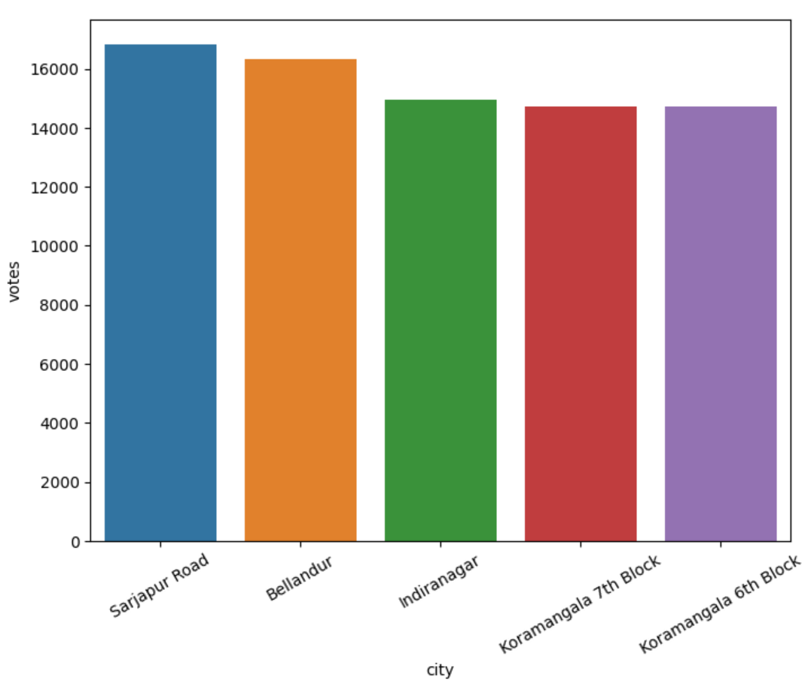
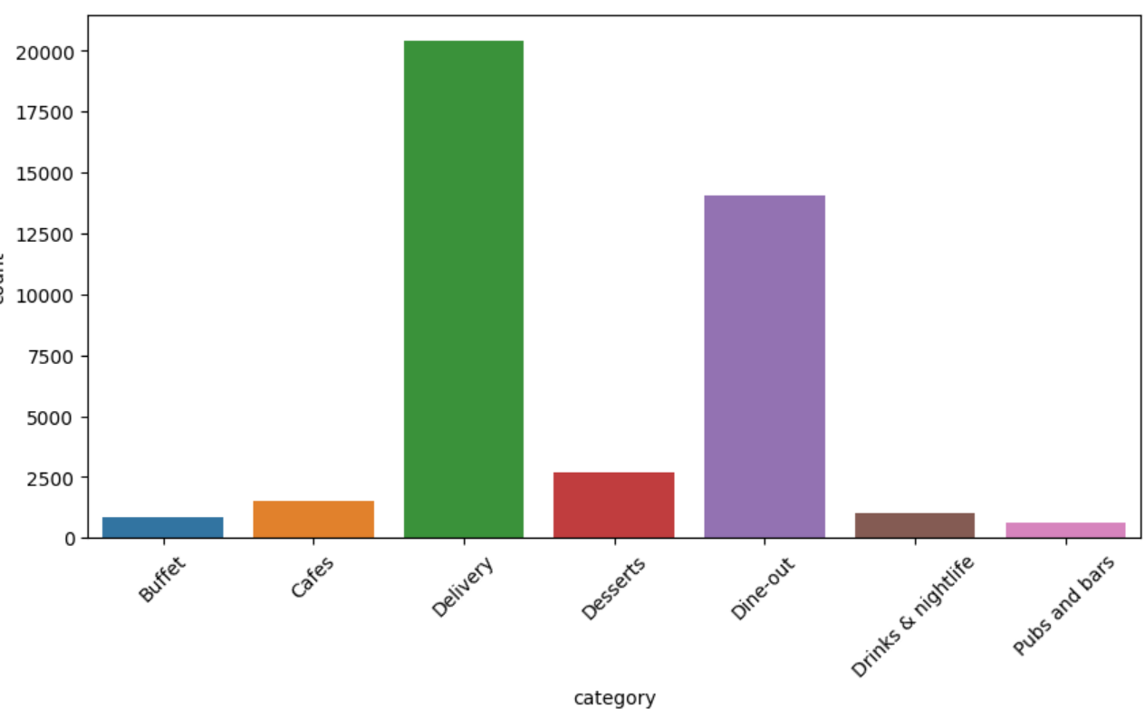
EDA results
fig.1.Number of votes of restaurants in the top 10 cities
fig.2.Countplot of category of restaurant

Slide 8
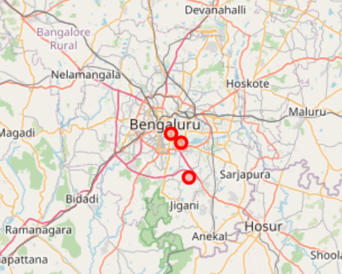
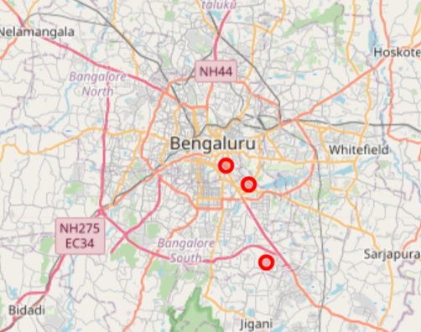
Mapped results of content vs hybrid filtering
fig.3.Content based filtering results
fig.4.Hybrid filtering results

Slide 9
References
[1].A. A. Mustafa and I. Budi, "Recommendation System Based on Item and User Similarity on Restaurants Directory Online," 2018 6th International Conference on Information and Communication Technology (ICoICT), Bandung, Indonesia, 2018, pp. 70-74, doi: 10.1109/ICoICT.2018.8528775.
[2].A. Tripathi and A. K. Sharma, "Recommending Restaurants: A Collaborative Filtering Approach," 2020 8th International Conference on Reliability, Infocom Technologies and Optimization (Trends and Future Directions) (ICRITO), Noida, India, 2020, pp. 1165-1169, doi: 10.1109/ICRITO48877.2020.9197946.
[3].N. Koetphrom, P. Charusangvittaya and D. Sutivong, "Comparing Filtering Techniques in Restaurant Recommendation System," 2018 2nd International Conference on Engineering Innovation (ICEI), Bangkok, Thailand, 2018, pp. 46-51, doi: 10.1109/ICEI18.2018.8448528.
[4].M. S. Alshammari, "A Restaurant Recommendation Engine Using Feature-based Explainable Matrix Factorization," 2022 Fifth National Conference of Saudi Computers Colleges (NCCC), Makkah, Saudi Arabia, 2022, pp. 26-30, doi: 10.1109/NCCC57165.2022.10067509.

Slide 10
Thank you

